Slide 1





Data Analysis Project

Slide 2





UK Train Rides project
Introduction
Data Modeling
Data Cleaning
Dashboard

Slide 3
1.Introduction
Objective :-
To analyze UK Train Rides to identify optimal routes, Pricing patterns, and service performance- providing actionable insights for travelers and operators

Slide 4
2. Data Cleaning
Data Cleaning is the first step in our analysis. This step is very important to ensure the dataset’s consistency and usability for analysis, several data cleaning steps were applied.

Slide 5
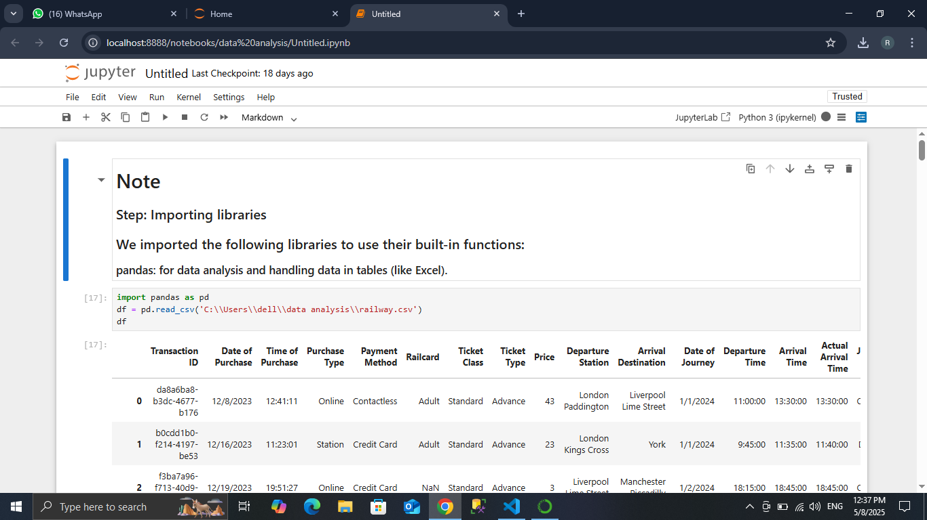

Slide 6
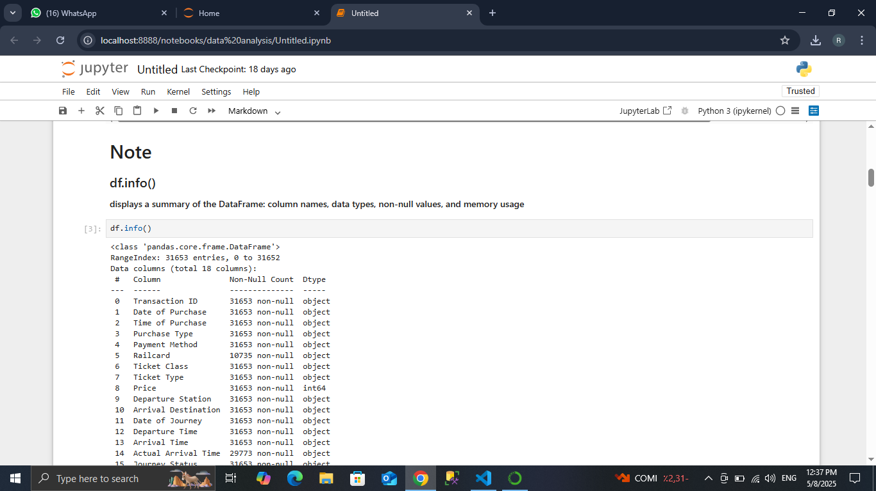

Slide 7
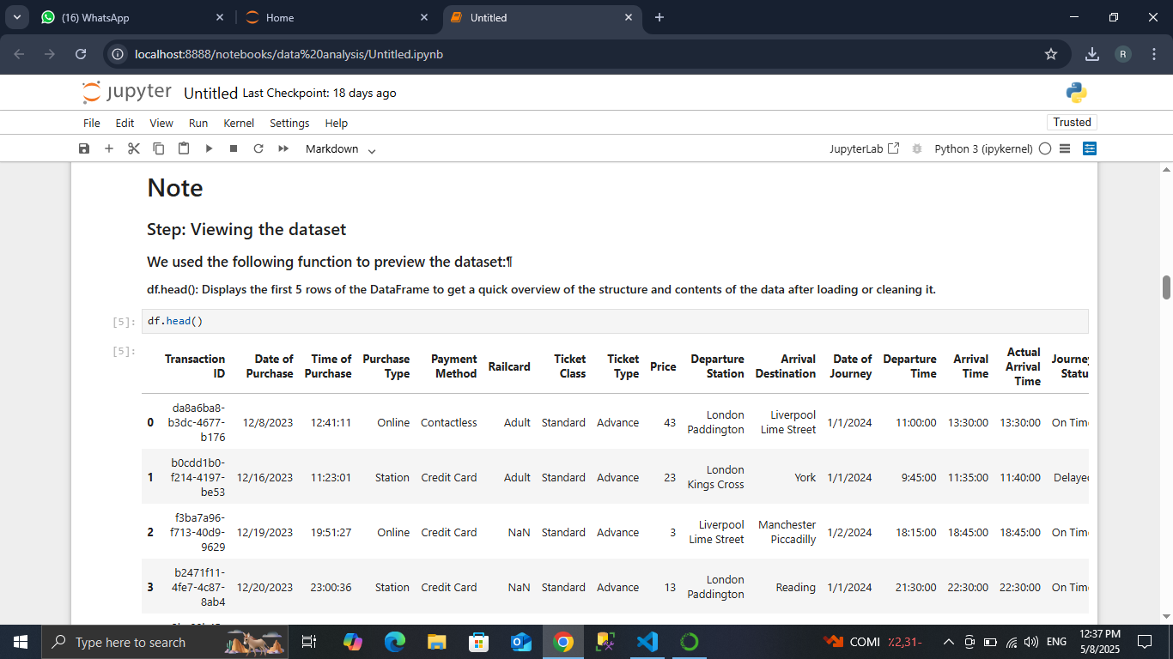

Slide 8
2. Data Modeling
The second step in our analysis is Data Modeling is the process of transforming cleaned and structured data into a suitable format for analytical or predictive purposes. It involves selecting appropriate algorithms, defining input features, and training models that can identify patterns or make predictions based on historical data.

Slide 9
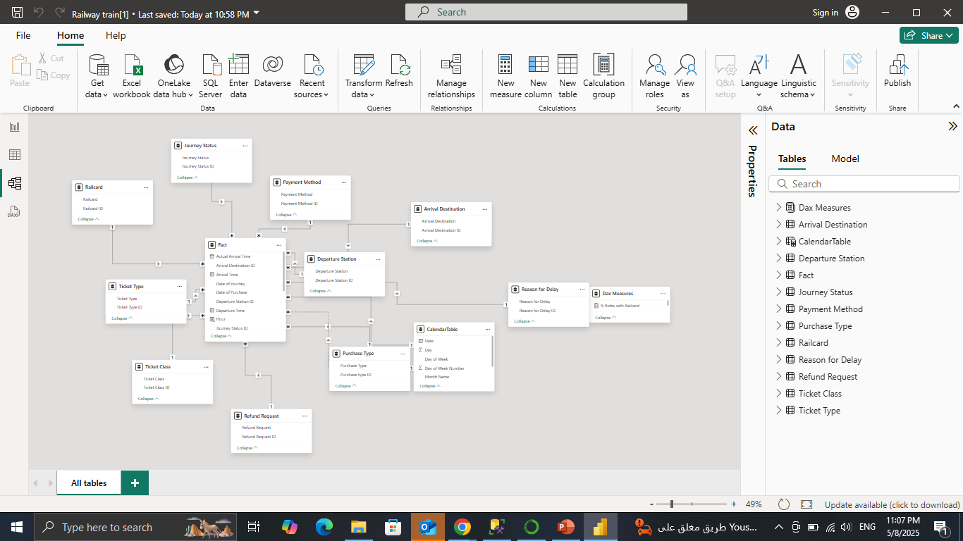
2.Data Modeling

Slide 10
3.Dashboard
The dashboard provides an interactive and visual representation of key metrics related to railway operations, including journey performance, ticketing, payment methods, delays, and refund requests. It is designed to support data-driven decision-making and improve operational efficiency.

Slide 11
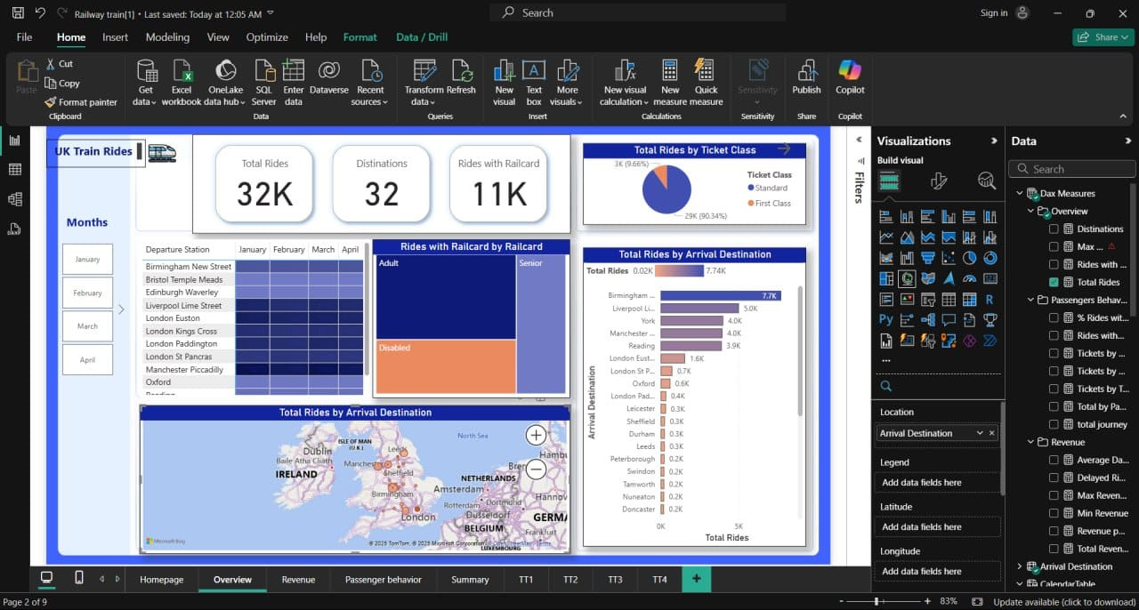

Slide 12
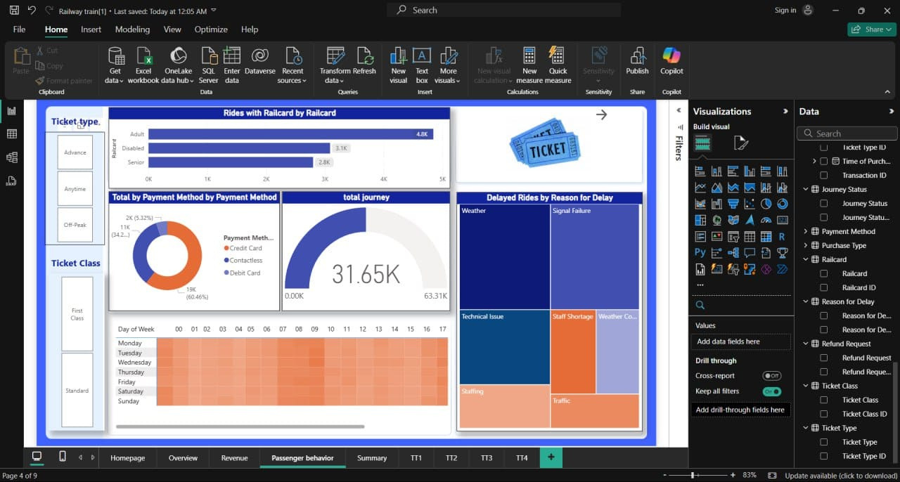

Slide 13
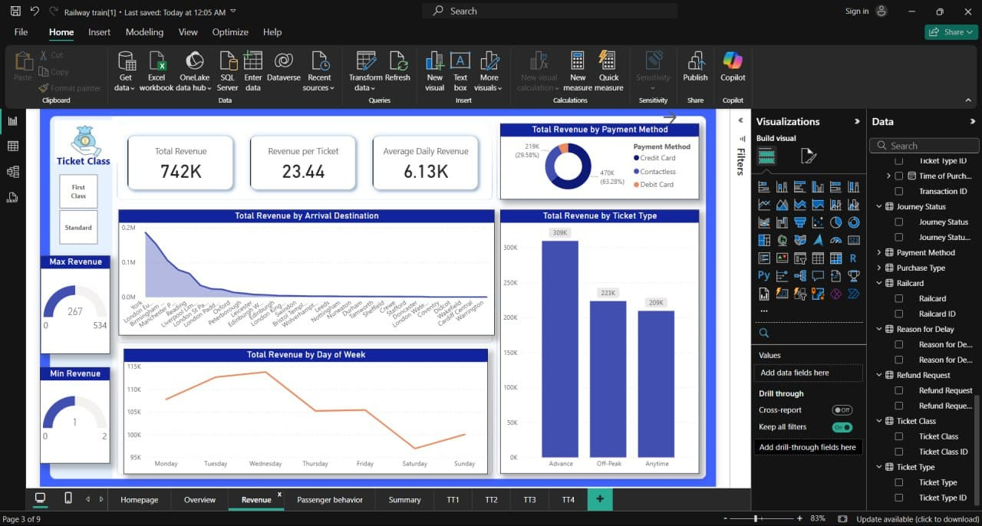

Slide 14
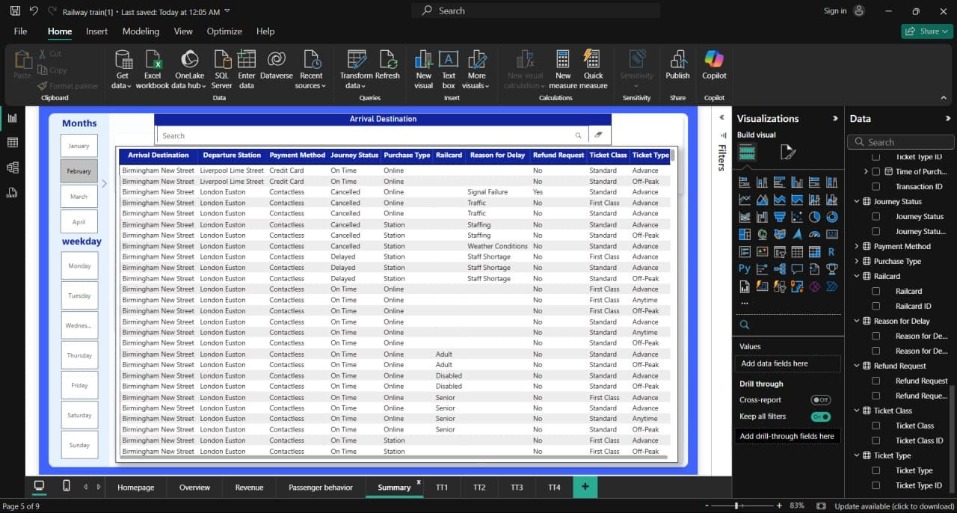

Slide 15


Tools Used
Python (Pandas Library)
Microsoft Power Bi

Slide 16
Group code:- CAI2_DAT1_S7
Team Work :-
Retaj Mohammed (Team Leader)
Mostafa Hesham
Malak Hani
Noran Sherif
Nermin Ahmed
Mohammed Ehab

Slide 17

Thanks

